Slide 1
Sugar – A White Death !!!
By Aditi Shah, Registered Dietitian Nutritionist & Health Coach
Notes:
NOTE: To replace a picture, just select and delete it. Then use the Insert Picture icon to replace it with one of your own!

Slide 2
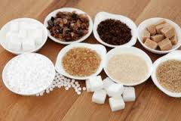
Objectives
Understand what is the difference between natural and artificial or added sugars
Identify popular drinks and foods that are high in added sugar
Natural alternatives to sugar
How to overcome sugar cravings

Slide 3
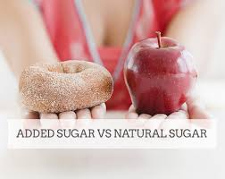
TYPES OF SUGAR
Naturally Occurring Sugar:
Fructose: found in all fruits & some vegetables.
Lactose: found in dairy and dairy products ( yogurt)
Added Sugars: those sugars that are removed from their original source .
ADDED to foods usually as a sweetener or as a preservative for longer shelf life.
The sugar added in home cooking is also form of added sugar.

Slide 4
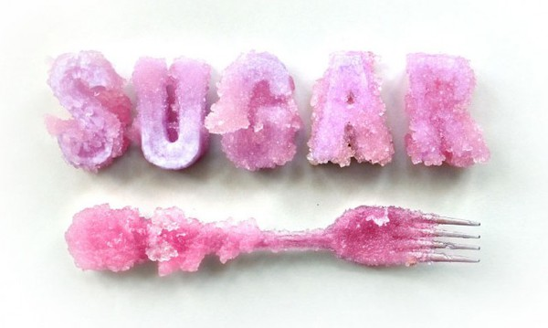
How Much Sugar Should People Need?
Adult men: 36 grams or 9 teaspoons a day
Adult women: 24 grams or 5 teaspoons a day
Teens: No more than 5-8 teaspoons
How many teaspoons a day do you think we REALLY get?

Slide 5
Hiding in Plain Sight: Other Names for Sugar
High fructose corn syrup
Sucrose
Raw sugar
Malt syrup
Molasses
Turbinado sugar
Crystalline fructose
Corn sugar
Fructose
Glucose
Honey
Dextrose
Beet sugar
Sorbitol
Agave Nectar

Slide 6
Hidden Sugar in foods

Slide 7
Hidden Sugar in foods
1 cliff bar – 25 gms of sugar = 6 Donuts

Slide 8
Hidden Sugars in healthy drinks

Slide 9
Rethink Your Drinks
1 bottle = 48 gms sugar = 12 Donuts
1 bottle= 32 gms sugar = 8 Donuts

Slide 10
New Drink Sensation
Starbucks Unicorn Frappuccino Venti has more sugar than…
Entire bag of Hostess Powdered Donettes (75 grams of sugar). This is 20 donettes!
Four large scoops Baskin Robbins Chocolate Chip Ice Cream (72 grams of sugar).
29 Hershey’s Kisses (75 grams of sugar).
The avg Adult Recommendation is 36gm/day, this is 2-3x more than normal limit.
- Making it a worst drink especially for kids.

Slide 11
¼ c = 29 gms sugar = 7 donuts
2 oz serving size = 37 gm sugar = 9 Donuts

Slide 12
Healthy Alternative To same foods

Slide 14
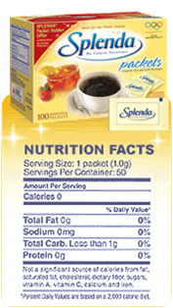
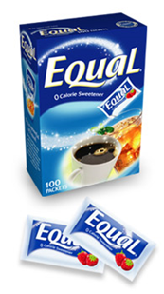
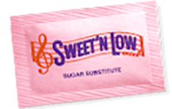
Artificial Sweeteners – Your Enemy
Recent research has shown that artificial sweeteners actually increase your cravings for sweet foods and make you eat more calories over the course of the day even if you save them on a drink or food.
Some research has even indicated that artificial sweeteners may increase your risk of diabetes.
Stick with real sugar while scaling back the amount you use and the portion sizes you eat.
Sweeteners may be hidden under many names on the package. If a product is zero calorie, it’s very likely to have a sweetener in it.
Say No to Sweet& low, Equal, Splenda

Slide 15
Natural Sugar Substitutes
Jaggery ( Gur) – ( 10 gm – 38 kcalories)
Stevia ( 0 kcalories)
Majdool Dates ( Medjool Date – 66 kcalories)
Banana Puree/ Apple sauce ( 1 c – 200 kcalories)
Dried Fruits ( varies with amount)
Agave Nectar ( 1 Tbsps. – 60 kcalories)
Coconut Sugar ( 1 Tbsps.- 45 kcalories)
Organic Pure Maple Sugar ( 1 Tbsps. – 52 kcalories)

Slide 16
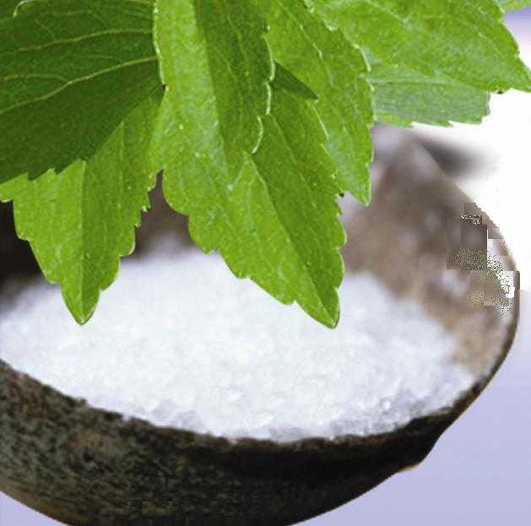
Stevia
South American herb
One of the most popular sugar substitutes
200x sweeter than sugar
Contains no calories
Doesn’t affect a person’s glycemic levels.
Beneficial in weight loss.
Boost bone health and helps reduce risk of osteoporosis.

Slide 17
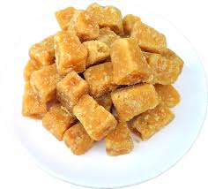
Jaggery
Natural Sweetener- perfect substitute for sugar which is loaded with various nutrients and is free from chemicals.
Acts as a blood purifier and helps to eradicate the health problems such as acne, indigestion, hair loss and joint pain.
Jaggery effectively cleans the respiratory tracts, lungs, food pipe, stomach and intestines.
Jaggery may have a better nutrition profile than sugar, but it’s still high in calories and is best consumed in moderation.

Slide 18
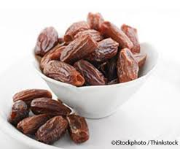
Dates
Loaded with potassium, copper, iron, manganese, magnesium and vitamin B6.
They are easily digested and help to metabolize proteins, fats and carbohydrates.
Evidence shows that dates may help to reduce LDL cholesterol in the blood and may reduce the risk of stroke.
How to use Dates: Use it as date paste. Mejdool dates are best to use.
Slightly higher in calories, so use in small amounts or moderation .

Slide 19
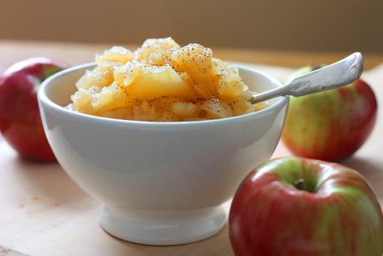
Apple sauce/ Banana Puree
Easy to find
Has 1/7 of the calories contained in regular table sugar
1:1 substitute ration for sugar in a recipe
Liquid ingredients should also be reduced to accommodate apple sauce
Bananas are rich in fiber and potassium, and a good source of vitamins B6 and C. They are also naturally sweet with a subtle flavor, making them a perfect natural sweetener.
Over ripe Banana are best. For every cup of sugar called for in a recipe, use one cup of banana puree.

Slide 20
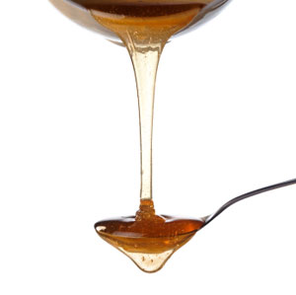
Agave nectar
Grown in the south US, Mexico, and South America
Contains calcium, iron, inulin, and other vitamins and minerals
25% sweeter than sugar
Can be used in cooking and baking
Agave nectar is suitable for a raw food or vegan diet- no bone char used.
It contains good amount of High Fructose Corn Syrup- which in huge amount can be harmful for the body.
Usually substitute 3/4 cup of nectar for every 1 cup of sugar in a recipe

Slide 21
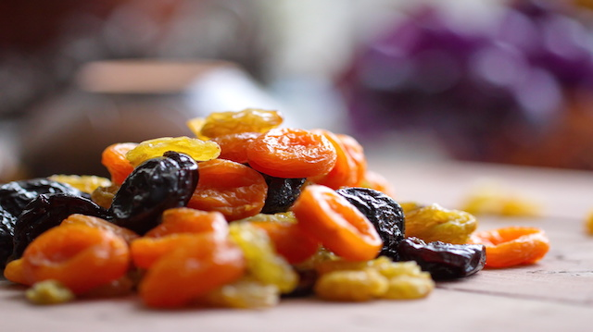
Dried Fruits
Are a great alternative to refined and artificial sweeteners in a recipe, and are an even better because they are whole foods.
Dried fruit retains the fiber, vitamins, and minerals of the whole fruit.
Dried fruit is a natural source of fructose, it’s also packed with fiber, B vitamins, and potassium.
Dried fruit goes great in oatmeal, baking recipes, energy bar recipes, and raw snack balls. One or two pieces can be used in a smoothie in place of liquid sweeteners.
Examples of Dried fruits that can be used are raisins, apricots, prunes, dried plums, mulberries
You can chop them for pockets of sweetness or soak over night then puree them as a liquid sugar substitute.

Slide 22
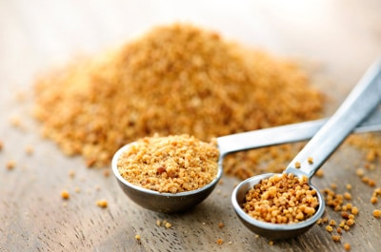
Coconut Sugar
Has low glycemic load and rich mineral content.
It contains a fiber called inulin, which may slow glucose absorption and explain why coconut sugar has a lower glycemic index than regular table sugar.
Packed with polyphenols, iron, zinc, calcium, potassium, antioxidants, phosphorous and other phytonutrients.
Use coconut sugar in your favorite recipes, for it measures just like sugar! It’s a bit more coarse than refined sugar, so the ratio is 1:1.
It supplies almost the same amount of fructose as regular sugar, gram for gram.
use coconut sugar, then use it sparingly. It is slightly “less bad” than regular sugar, but is no miracle food.

Slide 23
Organic Pure Maple Syrup
Maple syrup is an outstanding source of manganese, and contains calcium, potassium, and zinc.
Rich with antioxidants, this all-natural sweetener helps to neutralize free radicals and reduce oxidative damage.
Select darker, Grade B maple syrups, as they contain more beneficial antioxidants than the lighter syrups.
Make sure to get pure maple syrup, free of any fillers or high fructose corn syrup.
Maple syrup contains a small amount of minerals, especially manganese and zinc. However, it is also very high in sugar (about 67%).
Maple syrup is a “less bad” version of sugar

Slide 24
Natural ways to sweeten food
Spices:
When you want to enhance a sweet-like flavor, try using warm spices like 1 tsp cinnamon, ½ tsp cloves, ½ tsp allspice, and ½ tsp ginger. Try also 1-2 tsp or more of anise or fennel seeds.
Warming spices give the illusion of sweetness without the insulin jolt, and they can increase the illusion of sweetness.
Fresh Fruit: Try adding finely grated lemon zest or orange zest, or throwing in some frozen raspberries or cranberries combined with toasted walnuts or pecans.
Salt: Believe it or not, if you have a bare hint of salt, just the tiniest pinch, with your sweet, it creates a contrast in your mouth that makes the dessert taste better, and a touch sweeter, than if you added more sugar.

Slide 25
How to overcome sugar cravings
Drink a lot of water, at least 10-20 glasses /day .
Drinking Lemon/ lime water help with craving.
Frozen grapes, fresh berries,etc – good substitute.
Be Mindful Of Emotions- Many times our craving for sugar is more for an emotional need that isn't being met.
Distract Yourself- Go for a walk, if possible, in nature. Cravings usually last for 10-20 minutes max.
Take 200mcg chromium supplement once a day before any meal- to balance your body sugar levels.
Don’t be afraid of adding spices- such as cinnamon, nut meg, anise – help enhance natural sweetness.
Most Important – Get a good sleep – at least for 6-8 hours. .

